Slide 1
Selected Topics
Web Engineering

Slide 2
Usability
Usability can be defined as “the extent to which a product can be used by specified users within a specified usage context to achieve specified goals effectively, efficiently, and satisfactorily”.
So one has to consider:
  Who are the product’s users?
  What are the product’s goals?
  In what context is the product used?
  Can the goals be achieved effectively (i.e., completely and exactly), efficiently (at a justifiable cost relative to the achievement), and satisfactorily?

Slide 3
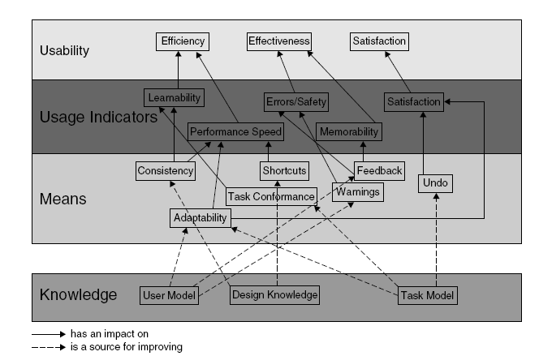
Layered Usability Model

Slide 4
Usability of Web Applications - Issues
Perception
  Layout of different elements should correspond to the mechanisms of human perception
Memory
  Capacity of human beings to remember is limited
  While surfing the Web, user needs to remember a lot of information
  With animations, banners and a lot of links it becomes difficult for the user to focus on the main task
Attention
  High level of animation/multimedia content is a source of distraction for the users

Slide 5
Design Guidelines
Response Times
  To ensure the feel of interactivity and active flow control the system must respond efficienty
  a system response time of 0.1 second is felt as a direct response
  waiting times of up to 3 seconds are acceptable without affecting the thinking process
  longer waiting times are perceived consciously (and normally unpleasantly).
    Response time of up to 3 secs is considered normal for Web Apps

Slide 6
Design Guidelines ..
Response Times
  Design ‘slim’ pages to reduce response time
  Reduce the no of images or use low-size formats for multimedia content (use thumbnails, or ALT text for images)
Interaction Efficiency
  The time user spends on navigation and input (form filling etc) is also important
  Minimise the distances to clickable elements
  Size of these elements should be good enough so that users can accurately click these items

Slide 7
Design Guidelines ..
Colours
  Avoid excessive use of colours
  roughly five colours are believed to represent the upper limit.
  Extreme hues, such as flashy or highly saturated colours, should be avoided.
Text Layout
  Reading on screen is not efficient
  Avoid fixed text layouts ( problems with resize of browser windows and font sizes)
  Avoid structures or patterns in the Web page backgrounds

Slide 8
Design Guidelines ..
Page Structure
  Avoid horizontal browsing
  menus and navigation elements, are best arranged on the left and upper page margins.

Slide 9
Navigation Structure
  The “getting lost in hyperspace syndrome” due to non-linear navigation has to be avoided at any cost.
  Provide a clear and logical basic structure, supported by a sitemap, constant feedback on the current position within the structure (“Where am I?”)
  Provide clear information about the content on the current page (“What can I do or find here?”)
  Give information about the items reachable in the next interaction step (“Where can I go?”)

Slide 10
Reference and Further Reading
Chapter 11
  Sections 11.1 to 11.4
  Read rest of the guidelines in Section 11.4

